Slide 1
SWE30003 Software Architectures and Design
Lecture 10 Service Oriented Architectures (SOA) and Web Services

Slide 2
Logistical matters
Weekly submissions – A & Q
Week 2: 104 & 101 out of 119;
Week 3: 101 & 98 out of 118;
Week 4: 102 & 101 out of 118;
Week 5: 98 & 98 out of 118;
Week 6: 88 & 84 out of 117;
Week 7: 108 & 104 out of 117;
Week 8: 91 & 93 out of 117;
Week 9: 103 & 98 out of 117;
Week 10: 97 & 94 out of 117;
No late submission, hurdle requirement
Assignment 3: Questions?

Slide 3
Question to Answer – Week 9
Discuss the differences, advantages, and disadvantages of data-centred and data-flow architectures. Give examples where either of these two styles would be applicable.

Slide 4
Required Readings - Week 10
Service Oriented Architectures (SOAP, REST, and Micro-Services)
Michael N. Huhns, Munindar P. Singh: Service-Oriented Computing: Key Concepts and Principles. IEEE Internet Comput.9(1): 75-81 (2005) (Link to an external site)
Stefan Tilkov: A Brief Introduction to REST. InfoQ (2007) (Link to an external site)
Chris Richardson: Microservices: Decomposing Applications for Deployability and Scalability. InfoQ (2014) (Link to an external site)
P Jamshidi, C Pahl, NC Mendonça, J Lewis, S Tilkov: Microservices: The journey so far and challenges ahead. IEEE Software (2018) (Link to an external site)

Slide 5
Additional Resources/Readings
Follow the links provided …
Michael Papazoglou: Web Services: Principles and Technology, Pearson/Prentice Hall, 2008. Chapters 1 & 2 (and more)
Leonard Richardson and Sam Ruby: RESTful Web Services, O’Reilly, 2007. Chapter 1 (and more)
Webber, Parastatidis, Robinson: REST in Practice, O’Reilly, 2010 (Free download http://it-ebooks.info/book/393/)
InfoQ (http://www.infoq.com): SOA, Web services, REST, Microservices, Enterprise Architecture, …

Slide 6
Content
Software services & web services
Some concepts you need to understand
Service oriented architecture (SOA)
Web application architectural styles and middleware
WS* (SOAP) approach
REST approach
Microservices

Slide 7
The Web
Initially, documents – for sharing between humans: documents on the web
Web Server: hosting documents
Web Client (Brower): reading/using documents
Distributed
Searchable/addressable
Extensible/unbounded
…

Slide 8
Enterprise (Software) Systems
Distributed
Integration (vs greenfield decomposition)
Business process
Cross-organisation, cross-geography
Large-scale
Addressable
Then, software – for sharing between machines (& between humans): software on the web
How? … make software a “service” deployable on the web

Slide 9
Service / Software Service / Web Service
A (software) service – beyond component:
Independently deployable,
Self-contained,
Self-describing,
Discoverable (open),
Composable,
Software system (component).
Not necessarily on the Web …
web service = service + web: a service deployed on the web using web technology.

Slide 10
Web Services: W3C Definition
Web Services in the Enterprise
A Web service is a software system identified by a URL, whose public interfaces and bindings are defined and described using XML.
Its definition can be discovered by other software systems
These systems may then interact with the Web service using XML based messages conveyed by Internet protocols (not necessarily Web protocols!)
?? Maybe if WADL is used
W3C definition does not apply to RESTful ‘Web services’!

Slide 11
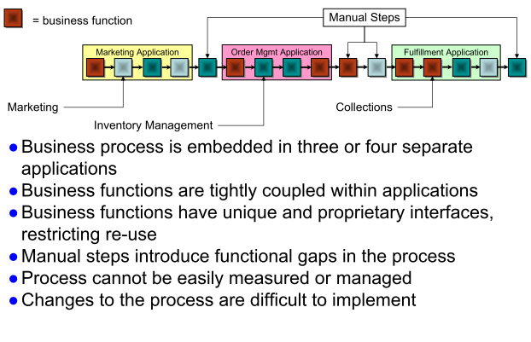
Need to make an existing business process more flexible
Web Services in the Enterprise – Example (business/sales process management)
Example from IBM Rational

Slide 12
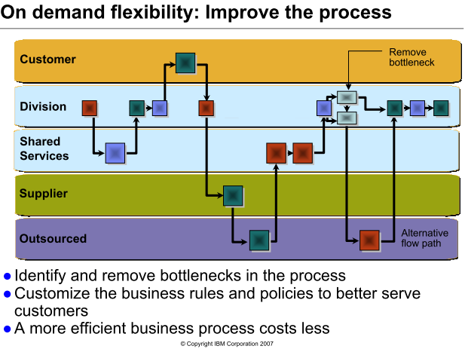

Slide 13
Web Services in the Enterprise
Advantages of Web Services for Business
Within an enterprise (Enterprise Application Integration)
Accelerate and reduce the cost of integration
Save on infrastructure deployment & management costs
Reduce skill requirements
Improve reuse
Improve flexibility leads quicker response to market opportunities
Between enterprises (e-Business integration)
Providing service to a company’s customers
e.g., an Insurance company wishes to link its systems to the systems of a new institutional customer (IAG for RACV, NRMA etc)
Accessing services from a company’s partners and suppliers
e.g., dynamically link to new partners and suppliers to offer their services to complement the value the company provides (Master Card from Coles)
Standards and common infrastructure reduce the barriers
Simplicity and reuse accelerates deployment
Dynamics opens new business opportunities

Slide 14
Content
Software services / web services
Some concepts you need to understand
Service oriented architecture (SOA)
Web application architectural styles and middleware
WS* (SOAP) approach
REST approach
Microservices

Slide 15
Some underlying concepts …
Functional and non-functional properties
Stateless and stateful services
Granularity
Synchronicity
Separation of interfaces and implementation
Loose coupling

Slide 16
Service Properties & State
Some concepts …
Functional & non-functional properties:
The functional service description details the operational characteristics that define the overall behavior of the service,
The non-functional description targets service quality attributes, e.g., service metering and cost, performance metrics (response time or accuracy), security, authorization, authentication, scalability, & availability, etc.
Stateless or stateful services:
Services that can be invoked repeatedly without having to maintain context or state are called stateless.
Simple informational services are stateless.
Services that require their context to be preserved from one invocation to the next are called stateful.
Complex services (business processes) typically involve stateful interactions.

Slide 17
Granularity
Some concepts …
Service granularity:
Simple services are discrete in nature, exhibit normally a request/reply mode of operation & are of fine granularity, i.e., they are atomic in nature.
Complex services are coarse-grained, e.g., a PurchaseOrder. These involve interactions with other services and possibly end-users in a single or multiple sessions.
Coarse-grained communication implies larger and richer data structures, (viz. those supported by XML).

Slide 18
Synchronous & asynchronous communication
Some concepts …
Synchronous communication which is synchronized between two communicating application systems, which must both up and running.
Execution flow at the client’s side is interrupted to execute the call.
Asynchronous communication where the caller employs a send and forget approach that allows it to continue to execute after it sends the message.
Here an application sends a request to another while it continues its own processing activities.
sending
application
receiving
application
request
block
request
processing
unblock
response

Slide 19
Service Interface (API) & Implementation
Some concepts …
The service interface defines service functionality visible to the external world and provides the means to access this functionality.
The service describes its own interface characteristics, i.e., the operations available, the parameters, data-typing and the access protocols, in a way that other software modules can determine what it does, how to invoke its functionality, & what result to expect in return.
The service implementation realizes a specific service interface whose implementation details are hidden from its users.
Different service providers using any programming language of their choice may implement the same interface.

Slide 20
Perspectives on Web Services
Client Perspective
Provider Perspective
What does it do?
How to represent it?
How to build it?
Interface
Implementation
How do I use it?
Where can I find it?
Where to host it?
How to publish it?

Slide 21
Loose Coupling
Some concepts …
Coupling indicates the degree of dependency any two systems have on each other. Some types relevant to enterprise computing include:
Type of Coupling | Problem Description | Reduced by
Functional | One module relies on the internal workings of others | Well defined interface/API describing inputs and outputs
Interface | Interfaces reflect the implementation details | Avoid detailed mandatory parameters; Use more general methods and message passing (do not get too fine-grained)
Data Structure | Data passed between modules reflects internal representations, or is over-constrained | Explicitly define formats, e.g XML in interface; Allow multiple representations e.g.mime-types; ‘Vertical’ standards that define semantics of messages
Temporal | Client blocked while waiting response Process over-constrained | Asynchronous messages; Explicitly define behaviour in interface e.g. abstract BPEL; Interaction via events / event-driven processes
Address/URI | Addresses change Providers change URI patterns change | Do not hard code references; Virtualise services; Use middleware directory services

Slide 22
Content
Software services / web services
Some concepts you need to understand
Service oriented architecture (SOA)
Web Application architectural styles and middleware
WS* (SOAP) approach
REST approach

Slide 23
Service Oriented Architecture
Web Architectural Styles – SOA
SOA is fundamentally of client-server style, and based on
the interaction between decoupled services and/or end-user applications
associated with messages & governed by policies.
services distributed in a network, via published and discoverable interfaces.
Service
Client
- Searchable directory where service descriptions can be published and searched.
- Contains sufficient information for the service requestor to contact, or bind to, the service provider and thus make use of the services it provides.
Roles
Find
Bind
3
2
Service
Description
Service
Provider
Service
Service
Registry
Publish
Service
Description
1

Slide 24
Web Architectural Styles
Web Architectural Styles
Fundamentally, client-server…. Sub-styles:
Method-oriented RPC (Remote Procedure Call)
Interface: Method, parameters
Interaction: synchronous request-response, request-acknowledge
Message-oriented (aka Document style)
Interface: Domain specific operation, Message type
Interaction: Various synch/asynch, request-response, one way, solicit-notify
Resource-oriented
Interface: generic CRUD, Resource id, Media type
Interaction: synchronous request-response, request-acknowledge
Event-oriented
Interface: event type
Interaction: Subscribe-notify, publish-subscribe-notify

Slide 25
Remote Procedure Calls - an oo/component approach
Web Architectural Styles - RPC
Object/component-oriented approach to distributed computing e.g. CORBA
Application elements use a request/wait-for-reply (synchronous) model of communication.
RPC-style programming leads to tight coupling of interfaces and applications.
Client
Remote
procedure code
Server
Remote
procedure
Application
code
Application
code
Stub code
Stub code
RPC run-time
library
RPC run-time
library
Network
In an RPC environment each application needs to know the intimate details of the interface of every other application – the number of methods it exposes & the details of each method signature it exposes.

Slide 26
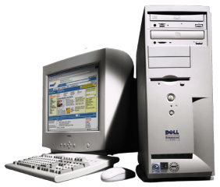
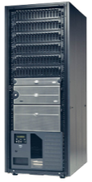
Asynchronous request/reply messaging
Web Architectural Styles - Messaging
Most asynchronous messaging mechanisms follow the “fire-and-forget” messaging principle where the sending application can conduct its work as usual once a message was asynchronously sent.
The sending application assumes that the message will arrive safely at its destination at some point in time.
This mode messaging does not preclude the necessity to perform request/reply operations.
Message channel
request
request
message
message
Message channel
reply
reply
message
message
Requester
Replier

Slide 27
Message-oriented Middleware
Web Architectural Styles – Message-oriented
MOM is an infrastructure that involves the passing of data between applications using a common communication channel that carries self-contained messages.
Messages are sent and received asynchronously.
The messaging system (integration broker) is responsible for managing the connection points between clients & for managing multiple channels of communication between the connection points.
Client
Client
Server
Application logic
Message
publication
Message
notification
MOM
MOM
MOM
MOM Integration Broker

Slide 28
Resource-oriented Architecture
Web Architectural Styles – Resource-oriented
Resources exposed on a network
Resources uniquely identified
Application is a series of linked resource updates between clients and servers
Resource examples
something returned by an SQL query
text or media file
a transaction
a web site
a downloadable program
...
CRUD:
Create, Read, Update, Delete

Slide 29
EDA – Event Driven Architectures
Web Architectural Styles – Event-oriented
Event emitters and consumers
Promotes further decoupling of business processes
Same event can be consumed by a number of other (possibly anonymous) processes.
Event emitter does not care who consumes the event
Fits well with declarative rules based approach to defining business processes (as distinct from an imperative activity based approach as in BPEL (ie, the WS composition language))
http://www.infoq.com/presentations/SOA‑Business‑Autonomous‑Components

Slide 30
How does SOA help achieve loose coupling?
Type of Coupling | Problem Description | Reduced by
Functional | One module relies on the internal workings others | Well defined interface/API describing inputs and outputs
Interface | Interfaces reflect the implementation details | Avoid detailed mandatory parameters; Use more general methods and message passing (do not get too fine-grained)
Data Structure | Data passed between modules reflects internal representations, or is over-constrained | Explicitly define formats, e.g XML in interface; Allow multiple representations e.g.mime-types; ‘Vertical’ standards that define semantics of messages
Temporal | Client blocked while waiting response Process over-constrained | Asynchronous messages; Explicitly define behaviour in interface e.g. abstract BPEL; Interaction via events / event-driven processes
Address/URI | Addresses change Providers change URI patterns change | Do not hard code references; Virtualise services; Use middleware directory services

Slide 31
Content
Software services / web services
Some concepts you need to understand
Service oriented architecture (SOA)
Web application architectural styles and middleware
WS* (SOAP) approach
REST approach
Microservices

Slide 32
Web Application (Standard) Approaches
Web Service Standards – “WS*”
SOAP message and WSDL interface descriptions
Stack of other WS* Standards (UDDI, WS-Transaction, WS-Security, … )
Service composition and orchestration
e.g. BPEL – Business Process Execution Language
Middleware based - many frameworks and technologies being developed
e.g. Web Sphere, JBoss, Apache Axis, WSO2, …
REST– based (Representational State Transfer)
Light-weight approach, inter-operability based on HTTP
View machine clients like automatic ‘browsers’
Resource/data centric
http://www.infoq.com/presentations/The-Counterintuitive-Web
Microservices: functions (data) as service …

Slide 33
Technologies for Web Architectures
Different Web ‘protocol patterns’ suit various architectural styles
Architectural Style
Standard Protocol patterns
RPC
Message-oriented
Resource-oriented
Event-oriented
WS* (SOAP, WDSL, …)
RESTful / Microservices
Note: There are many Web applications that do not follow these standard approaches

Slide 34
????
Which architectural style is the most “decoupled”?
Which architectural style is the hardest to change / evolve? a.k.a “Fragile”
Method-oriented
Message-oriented
Resource-oriented
Event-oriented
Coupling of reference address, interface, implementation, behaviour, …
Fragility - What breaks when something is changed?

Slide 35
Content
Software services / web services
Some concepts you need to understand
Service oriented architecture (SOA)
Web application architectural styles and middleware
WS* (SOAP) approach
REST approach
Microservices

Slide 36
WS* (SOAP) Architectures
Evolution of the enterprise computing middleware approach
CORBA, MoM, ESB
* = Standards needed, so enterprise system can interoperate
Description, Discovery, QoS, Security, Transactions, etc.
“Big” Web Services – many big vendors developing middleware products to support standards based approach
IBM, BEA, Microsoft, JBoss, WSO2, ...
An application protocol (SOAP), views/uses HTTP as a transport protocol to carry SOAP messages
Although almost always HTTP, such SOAP services can use other transports i.e. they are not necessarily “Web” services.
Calls/Messages defined and exchanged by machine using XML Schema

Slide 37
Message Exchange Patterns
Four common types of operations that represent possible combinations of input and output messages
Support for both push and pull interaction models at the interface level.
Not just client-server request - response
One
One
One
-
-
-
way Messaging
way Messaging
way Messaging
SOAP Message
SOAP Message
SOAP Message
Service consumer end-point
Service provider end-point
Request/Response Messaging
Request/Response Messaging
Request/Response Messaging
Request/Response Messaging
SOAP Request
SOAP Request
SOAP Request
SOAP Request
SOAP Response
SOAP Response
SOAP Response
SOAP Response
Service consumer end-point
Service end-point
Notification Messaging
Notification Messaging
Notification Messaging
SOAP Notification
SOAP Notification
SOAP Notification
Service consumer end-point
Service end-point
Solicit/Response Messaging
Solicit/Response Messaging
Solicit/Response Messaging
SOAP Request Message
SOAP Request Message
SOAP Request Message
SOAP Answer Message
SOAP Answer Message
SOAP Answer Message
Service end-point

Slide 38
Web Services and Messaging
WS* approach defines a standard messaging format called SOAP (originally defined as Simple Object Access Protocol)
Can use multiple application protocols for transport:
HTTP, HTTPS, SMTP, …
WSDL (service interface description) is designed to work with SOAP

Slide 39
WS Technology Stack implementation of SOA
Web services are implemented by a collection of several related technologies & standards.
Choreography - CDL4WS
Business Processes
Orchestration - BPEL4WS
Transactions
Quality of Service
WS-Reliability
WS-Security
Coordination
Management
Context
UDDI
Discovery
Description
WSDL
Description
SOAP
Message
XML
HTTP,JMS, SMTP
Transport
WS* Standards are defined in XML Schema

Slide 40
WSDL – Web Service (Interface) Description
Interface descriptions
Structure of WSDL documents
Abstract part
Concrete part

Slide 41
An example: in programming language style (illustration only)
Service StokeQuote {
//types
struct TradePriceRequestType { //RPC
string tickerSymbol;
};
struct TradePriceType{
float price;
};
Interface StokeQuotePortType {
void GetLastTradePrice
(in TradePriceRequestType GetLastTradePriceInput,
out TradePriceType GetLastTradePriceOutput);
… …
};
};

Slide 42
Web services in context
For “use of service” to happen, the consumer needs to understand and the provider needs to tell:
What the service can do – functionality: (by WSDL …)
How good the service can do it – qualities: (partly by other WS standards …)
How to use the service – usage: (partly by WSDL …)
How can we achieve this “understanding”:
Self-describing Web service interface (in WSDL, and …)
Platform independent (in XML)
Provider / Registry tells …
Consumer understands …

Slide 43
Web Services Description Language
The Web Services Description Language (WSDL) is the XML-based service representation language used to describe the details of the complete interfaces exposed by Web services and thus is the means to accessing a Web service.
For instance, neither the service requester nor the provider should be aware of each other’s technical infrastructure, programming language or distributed object framework (if any).
WSDL is a platform-independent description meant to be created and read by machines (not hand-written)
Generated from code objects or ide design tools

Slide 44
Structure of WSDL documents
WSDL documents can be separated into distinct sections:
The service interface definition describes the general web service interface structure. This contains all the operations supported by the service, the operation parameters and abstract data types.
The service implementation part binds the abstract interface to a concrete network address, to a specific protocol and to concrete data structures.
This enables each part to be defined separately and independently, and reused by other parts
The combination of these two parts contains sufficient information to describe to the service requester how to invoke and interact with the web service at a provider’s site.

Slide 45
<wsdl:definitions name="PurchaseOrderService"
targetNamespace="http://supply.com/PurchaseService/wsdl"
xmlns:tns="http://supply.com/ PurchaseService/wsdl"
xmlns:xsd="http://www.w3.org/2001/XMLSchema"
xmlns:soapbind="http://schemas.xmlsoap.org/wsdl/soap/"
xmlns:wsdl="http://schemas.xmlsoap.org/wsdl/">
<wsdl:types>
<xsd:schema
targetNamespace=http://supply.com/PurchaseService/wsdl>
<xsd:complexType name="CustomerInfoType">
<xsd:sequence>
<xsd:element name="CusNamer" type="xsd:string"/>
<xsd:element name="CusAddress" type="xsd:string"/>
</xsd:sequence>
</xsd:complexType>
<xsd:complexType name="POType">
<xsd:sequence>
<xsd:element name="PONumber" type="integer"/>
<xsd:element name="PODate" type="string"/>
</xsd:sequence>
</xsd:complexType>
<xsd:complexType name="InvoiceType">
<xsd:all>
<xsd:element name="InvPrice" type="float"/>
<xsd:element name="InvDate" type="string"/>
</xsd:all>
</xsd:complexType>
</xsd:schema>
</wsdl:types>
<wsdl:message name="POMessage">
<wsdl:part name="PurchaseOrder" type="tns:POType"/>
< wsdl:part name="CustomerInfo" type="tns:CustomerInfoType"/>
</wsdl:message>
<wsdl:message name="InvMessage">
<wsdl:part name="Invoice" type="tns:InvoiceType"/>
</wsdl:message>
<wsdl:portType name="PurchaseOrderPortType">
<wsdl:operation name="SendPurchase">
<wsdl:input message="tns:POMessage"/>
<wsdl:output message="tns:InvMessage"/>
</wsdl:operation>
</wsdl:portType>
</wsdl:definitions>
Example of Abstract WSDL
Interface definition
Abstract data type
definitions
Data that is sent
Data that is returned
Port type with
one operation
An operation with
request (input) &
response (output)
message

Slide 46
<wsdl:definitions> . …
<import namespace="http://supply.com/PurchaseService/wsdl"
location="http://supply.com PurchaseService/wsdl/PurchaseOrder-interface.wsdl"/>
<!-- location of WSDL PO interface from Listing-1-->
<!-- wsdl:binding states a serialisation protocol for this service -->
<!-- type attribute must match name of portType element in Listing-1-->
<wsdl:binding name="PurchaseOrderSOAPBinding"
type="tns:PurchaseOrderPortType">
<!-- leverage off soapbind:binding synchronous style -->
<soapbind:binding style="rpc"
transport="http://schemas.xmlsoap.org/soap/http/"/>
<wsdl:operation name="SendPurchase">
<!-- again bind to SOAP -->
<soapbind:operation
soapAction="http://supply.com/ PurchaseService/wsdl/ SendPurchase" style="rpc"/>
<!-- furthur specify that the messages in the wsdl:operation use SOAP -->
<wsdl:input>
<soapbind:body use="literal"
namespace="http://supply.com/PurchaseService/wsdl"/>
</wsdl:input>
<wsdl:output>
<soapbind:body use=“literal"
namespace="http://supply.com/ PurchaseService/wsdl"/>
</wsdl:output>
</wsdl:operation>
</wsdl:binding>
<wsdl:service name=“PurchaseOrderService">
<wsdl:port name=“PurchaseOrderPort" binding="tns:PurchaseOrderSOAPBinding">
<!-- give the binding a network endpoint address or URI of service -->
<soapbind:address location="http://supply.com:8080/PurchaseOrderService"/>
</wsdl:port>
</wsdl:service>
</wsdl:definitions>
Listing 2:
Example of WSDL
Implementation
Bind an abstract operation
to this implementation &
map the abstract
input & output messages
to these concrete messages
Service name
Network address of service

Slide 47
SOAP (Simple Object Access Protocol)
an XML-based communication protocol for exchanging messages between computers, regardless of their operating systems or programming environments
Overcomes the problems of conventional distributed object models
Does not require uniform object model across applications
Loose-coupling/strong encapsulation for applications (no internal object ref)
Designed to work with WSDL http://schemas.xmlsoap.org/wsdl/
Use HTTP - work over firewalls or proxy servers, e.g, most firewalls are configured to allow Hypertext Transfer Protocol (HTTP) to pass across

Slide 48
What is SOAP?
The standard messaging protocol used by Web services
Primarily for inter-application communication (‘server’ to ‘server’)
Use an XML-based scheme for encoding message (request and response) data
Typically uses HTTP as a means for transport
service requestor
service provider
application object
(client)
application object
(service provider)
SOAP-based middleware
SOAP-based middleware
SOAP messages exchanged on top of, HTTP, SMTP, JMS or other transport
converts procedure calls to/from XML messages sent through HTTP or other protocols.

Slide 49
SOAP as a lightweight protocol
SOAP is a lightweight protocol that allows applications to pass messages and data back and forth between disparate systems in a distributed environment enabling remote method invocation.
Lightweight: SOAP protocol possesses only two fundamental properties. It can :
send and receive HTTP (or other) transport protocol packets, and
process XML messages.
Supports both RPC and message (document) style interaction
This can be contrasted with the heavyweight protocols such as ORPC protocols. Designed to work with these.
Guiding principle:
“First invent no new technology”
http://msdn.microsoft.com/en-us/magazine/bb985060.aspx

Slide 50

Distributed messaging with SOAP
Web-service
requester
Web-service
provider
4
Client
Application
Web-service
Application
6
3
1
Web-service
implementation
infrastructure
SOAP message
XML document
SOAPserver
5
2
Network Transport
Protocol
(HTTP)
Network Transport
Protocol
(HTTP)
firewall
Distributed messaging
using SOAP

Slide 51
SOAP messages
SOAP is based on message exchanges.
Messages are seen as envelopes where the application encloses the data to be sent.
A SOAP message consists of an <Envelope> element containing an optional <Header> and a mandatory <Body> element.
The contents of these elements are application defined and not a part of the SOAP specifications.
A SOAP <Header> contains blocks of information relevant to how the message is to be processed. This helps pass information in SOAP messages and it is not application payload.
The SOAP <Body> is where the main end-to-end information conveyed in a SOAP message must be carried.
SOAP envelope
SOAP header
header block
SOAP body
body entry

Slide 52
Example of RPC-style SOAP body
<env:Envelope
xmlns:SOAP=“http://www.w3.org/2003/05/soap-envelope”
xmlns:m="http://www.plastics_supply.com/product-prices">
<env:Header>
<tx:Transaction-id
xmlns:t=”http://www.transaction.com/transactions”
env:mustUnderstand='1'>
512
</tx:Transaction-id>
</env:Header>
<env:Body>
<m:GetProductPrice>
<m:product-id> 450R6OP </m:product-id >
</m:GetProductPrice >
</env:Body>
</env:Envelope>
Corresponding method invocation in programming language style:
GetProductPrice(“450R6OP”);

Slide 53
Example of RPC-style SOAP response message
<env:Envelope
xmlns:SOAP=“http://www.w3.org/2003/05/soap-envelope”
xmlns:m="http://www.plastics_supply.com/product-prices">
<env:Header>
<--! – Optional context information -->
</env:Header>
<env:Body>
<m:GetProductPriceResponse>
<m:product-price> 134.32 </m:product-price>
</m:GetProductPriceResponse>
</env:Body>
</env:Envelope>
Corresponding method invocation in programming language style:
134.32

Slide 54
Implementing WS* Web Services
Design and implement an OO software system
Generate WSDL interface
Deploy service
Publish WSDL interface (API)
Other services/systems use

Slide 55
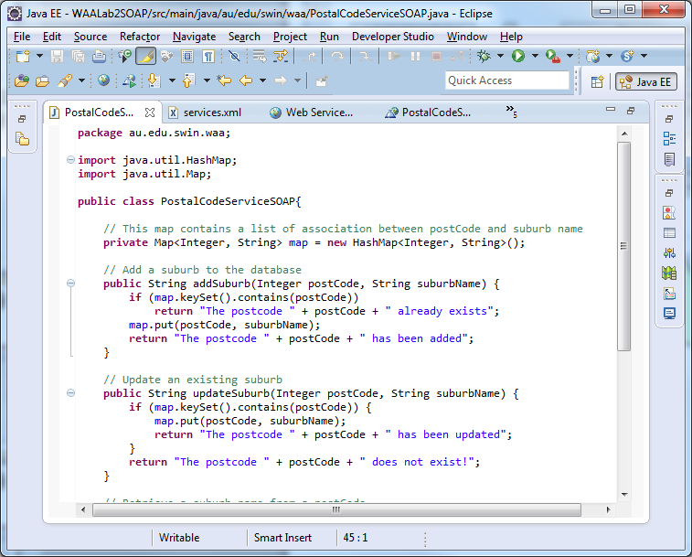
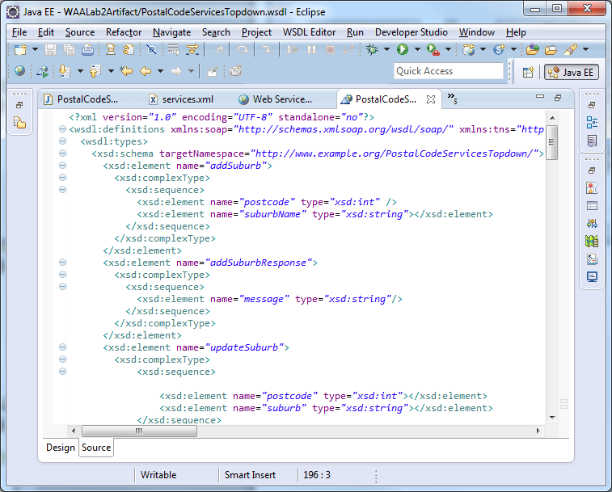
Code to WSDL

Slide 56
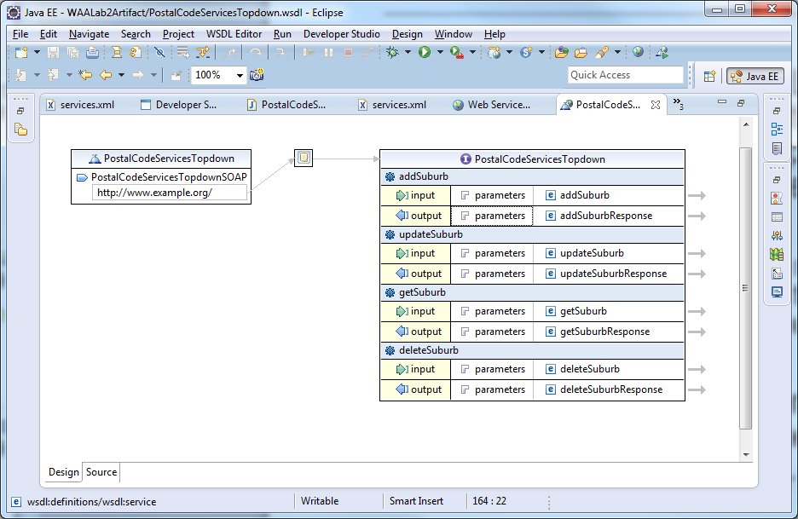
Design tool to WSDL

Slide 57
Content
Software services / web services
Some concepts you need to understand
Service oriented architecture (SOA)
Web application architectural styles and middleware
WS* (SOAP) approach
REST approach
Microservices

Slide 58
REST based architectures
Purist and Hybrid approaches
RESTful Web Services (purists)
HTTP as an application protocol
‘Resource-oriented’ architecture
Everything referenced as a URI
HTTP ‘verbs’ have specific meaning → uniform CRUD interface
GET – retrieve information on a resource
POST – Create a new resource
PUT – Modify an existing resource
DELETE – Delete an existing resource
Also use HEAD (get meta-data), OPTIONS (check which verbs supported)
E.g. Most Yahoo’s web services, Amazon’s S3 (Simple Storage Service)

Slide 59
REST – a resource-oriented architecture
Representational State Transfer
Expose resources to clients on a networked system
Everything referenced as a URI
Client-server architecture
Application state is driven by the client’s updating resources across the resource network using links provided by the server(s)
“Hypermedia is the engine of state”
What is a resource? Not just relational XML infosets
something returned by an SQL query, text file, media file, a transaction, a queue, a web site, a downloadable program, ...
REST is a style or “design guideline” – not a standard

Slide 60
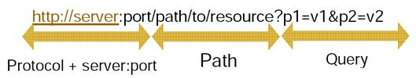
REST – Resource identification
All resources (services) referenced by a unique URI
e.g. GET

Slide 61
REST Methods – strict HTTP
RESTful Web Services (purist)
HTTP as an application protocol
HTTP ‘verbs’ have specific meaning → uniform CRUD interface for keeping resources updated:
GET – retrieve information on a resource
POST – Create a new resource
PUT – Modify an existing resource
DELETE – Delete an existing resource
Also use HEAD (get meta-data), OPTIONS (check which verbs supported)
E.g. Most Yahoo’s web services, Amazon’s S3 (Simple Storage Service)

Slide 62
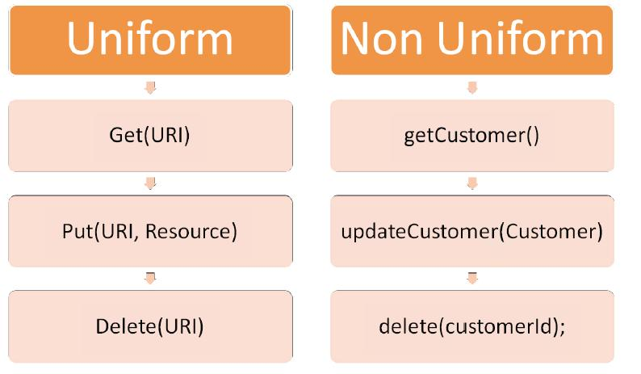
REST presents a uniform interface
Graphic courtesy of CSE UNSW

Slide 63
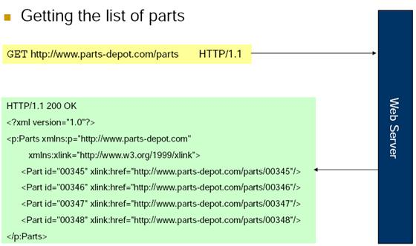
REST Example
Step 1 : Client asks for a list of parts
Graphic courtesy of CSE UNSW

Slide 64
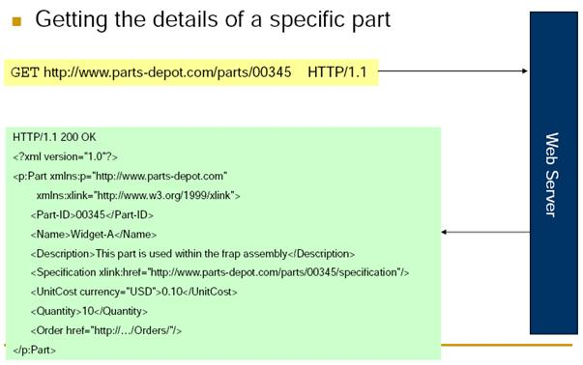
REST Example
Step 2. Given the part number ….
Graphic courtesy of CSE UNSW

Slide 65
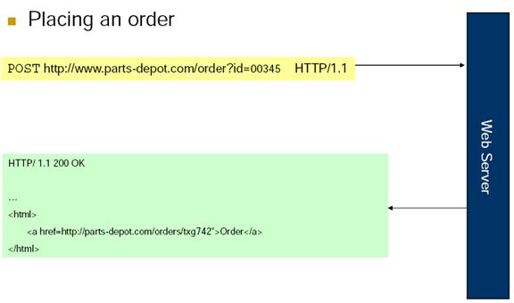
REST example
Placing an order (i.e. creating a new order resource)
POST http://www.parts-depot.com/order/00345 HTTP/1.1
Graphic courtesy of CSE UNSW

Slide 66
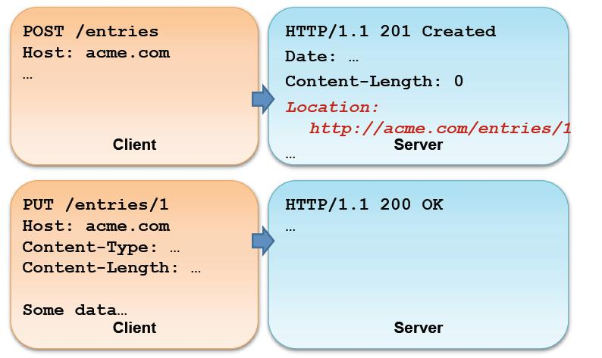
REST example
Updating a resource
Graphic courtesy of CSE UNSW

Slide 67
Implementing REST Web Services
Design and implement an OO software system (main class with CRUD)
Deploy service (with API)
Publish API interface
Other services/systems use

Slide 68
WS* vs RESTful?
 | WS* | RESTful
Easy to understand approach | Complex | Simpler
Easy to implement | Depends... | Depends...
Interface definition | Specific | Generic
Interface Contracts | Yes - WSDL | Not yet (WADL?)
Specific to the Web | No | Yes
Implementation of SOA | Yes | Not really
Scalable | Hmmm.... | Yes
Addresses enterprise concerns (e.g. transactions, end-end security) | Yes | Not directly
Orientation | Method | Resource

Slide 69
Content
Software services / web services
Some concepts you need to understand
Service oriented architecture (SOA)
Web application architectural styles and middleware
WS* (SOAP) approach
REST approach
Microservices

Slide 70
Microservices
An architectural approach - Some perspectives
A type of SOA
Functional perspective - Business functionality/capability oriented partition
Modular
Small (capability) & light-weight (technology: REST)
Self-contained & deployable
Oriented towards development, delivery & deployment
Scalable
Granularity vs Complexity …

Slide 71
Question to Answer – Week 10
Discuss the relationships (commonalities and differences) between the concepts of software service, SOAP web service, REST web service, and microservice.

Slide 72
Required Reading Week 11
Len Bass, Paul Clements, and Rick Kazman, Software Architecture in Practice (4th Edition), Addison-Wesley, 2021, Chapter 22. OR,
Len Bass, Paul Clements, and Rick Kazman, Software Architecture in Practice (3rd Edition), Addison-Wesley, 2013, Chapter 18.

